Slide 1
Reserved for Intro Picture
NAV MRP - “Marketing Runs the Place”
Please contact Tim for Assistance
John Grant
Sr. Application Consultant
jgrant@innovia.com
Picture

Slide 2
NAV Reordering Policies Overview 101
NAV Reorder Policies
NAV Planning Worksheets
Advanced Features For The Planner
Notes:
We help small and medium size businesses leverage technology to become more productive and profitable. (Give examples of what we do for some of these companies.)

Slide 3
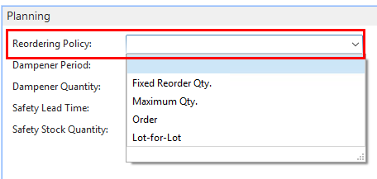
Reorder Policies
Notes:
We help small and medium size businesses leverage technology to become more productive and profitable. (Give examples of what we do for some of these companies.)

Slide 4
Reorder Policies
Blank
Manually Plan this item
Notes:
We help small and medium size businesses leverage technology to become more productive and profitable. (Give examples of what we do for some of these companies.)

Slide 5
Reorder Policies
Fixed Reorder Quantity
Uses the quantity that is specified in the Reorder Quantity field as the standard lot size. The quantity may be adjusted to meet additional requirements or the specified inventory
The Reorder Quantity field is used for calculating the overflow level
Notes:
We help small and medium size businesses leverage technology to become more productive and profitable. (Give examples of what we do for some of these companies.)

Slide 6
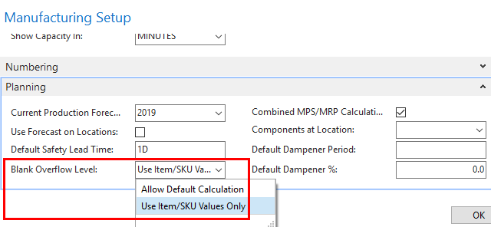
Reorder Policies
The Reorder Quantity field is used for calculating the Overflow Level
Notes:
We help small and medium size businesses leverage technology to become more productive and profitable. (Give examples of what we do for some of these companies.)

Slide 7
Reorder Policies Fixed Reorder Qty.
Notes:
We help small and medium size businesses leverage technology to become more productive and profitable. (Give examples of what we do for some of these companies.)

Slide 8
Reorder Policies
Maximum Reorder Quantity
Uses the quantity that is specified in the Maximum Inventory field to determine the maximum lot size. The quantity may be adjusted to meet additional requirements or the specified inventory level.
The Maximum Inventory field is used for calculating the overflow level
Notes:
We help small and medium size businesses leverage technology to become more productive and profitable. (Give examples of what we do for some of these companies.)

Slide 9
Reorder Policies Maximum Qty.
Notes:
We help small and medium size businesses leverage technology to become more productive and profitable. (Give examples of what we do for some of these companies.)

Slide 10
Reorder Policies
Lot-for-Lot
Generates an order proposal with a quantity that meets the sum of the requirements that are due in the planning period.
Notes:
We help small and medium size businesses leverage technology to become more productive and profitable. (Give examples of what we do for some of these companies.)

Slide 11
Reorder Policies Lot-for Lot
Notes:
We help small and medium size businesses leverage technology to become more productive and profitable. (Give examples of what we do for some of these companies.)

Slide 12
Reorder Policies
Order
Generates an order for each requirement and does not use the planning period. An automatic reservation between the requirement and the corresponding replenishment order proposal is created. This preserves the customized information on the relevant orders and links them for inventory and costing.
Creating a manual reservation is an alternate method for setting aside items in inventory and designating them for use in a specific order.
Notes:
We help small and medium size businesses leverage technology to become more productive and profitable. (Give examples of what we do for some of these companies.)

Slide 13
Reorder Policies Order
Notes:
We help small and medium size businesses leverage technology to become more productive and profitable. (Give examples of what we do for some of these companies.)

Slide 14
NAV Planning Worksheets
Purchasing Requisition Worksheet
Assembly Planning Worksheet
Manufacturing Planning Worksheet
Notes:
We help small and medium size businesses leverage technology to become more productive and profitable. (Give examples of what we do for some of these companies.)

Slide 15
NAV Planning Worksheets
Purchasing Requisition Worksheet
This calculates a replenishment plan for items and stockkeeping units that have been set up with a replenishment system of Purchase or Transfer only.
Notes:
We help small and medium size businesses leverage technology to become more productive and profitable. (Give examples of what we do for some of these companies.)

Slide 16
NAV Planning Worksheets
Assembly Planning Worksheet
Use the Calculate Plan batch job. This calculates a replenishment plan for items and stockkeeping units that have been set up with a requisition system of Purchase, Transfer, Prod. Order or Assembly
Notes:
We help small and medium size businesses leverage technology to become more productive and profitable. (Give examples of what we do for some of these companies.)

Slide 17
NAV Planning Worksheets
Manufacturing Planning Worksheet
Use the Calculate Plan batch job. This calculates a replenishment plan for items and stockkeeping units that have been set up with a requisition system of Purchase, Prod. Order, Transfer, or Assembly
Notes:
We help small and medium size businesses leverage technology to become more productive and profitable. (Give examples of what we do for some of these companies.)

Slide 18
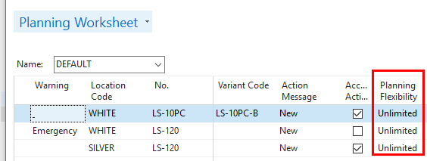
Advanced Features For The Planner
Planning Flexibility
Notes:
We help small and medium size businesses leverage technology to become more productive and profitable. (Give examples of what we do for some of these companies.)

Slide 19
Advanced Features For The Planner
Alternate Routing No.
Alternate Production Bom No.
Notes:
We help small and medium size businesses leverage technology to become more productive and profitable. (Give examples of what we do for some of these companies.)

Slide 20
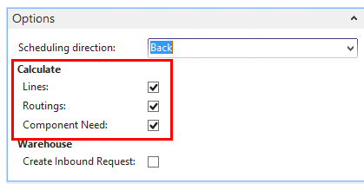
Advanced Features For The Planner
Alternate Routing No.
Alternate Production Bom No.
Notes:
We help small and medium size businesses leverage technology to become more productive and profitable. (Give examples of what we do for some of these companies.)

Slide 21
Advanced Features For The Planner
Alternate Production Bom No.
Alternate Routing
Notes:
We help small and medium size businesses leverage technology to become more productive and profitable. (Give examples of what we do for some of these companies.)

Slide 22
Advanced Features For The Planner
Why ? Order Tracking
Notes:
We help small and medium size businesses leverage technology to become more productive and profitable. (Give examples of what we do for some of these companies.)

Slide 23
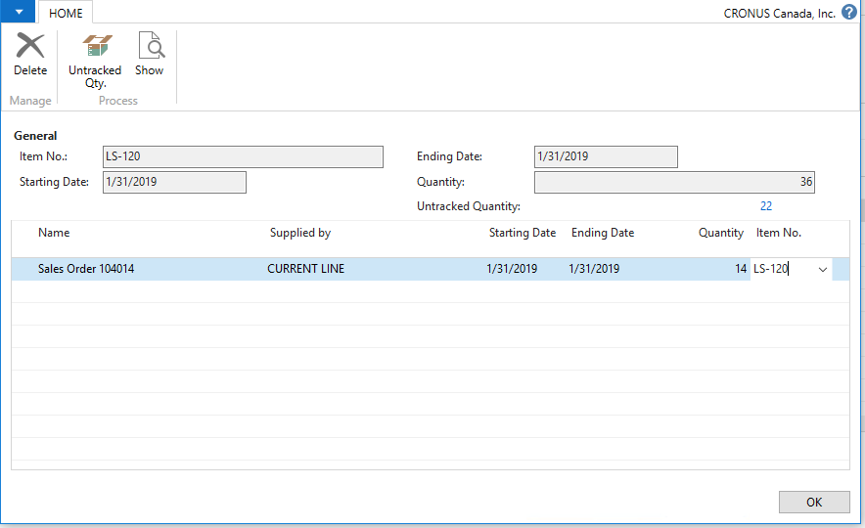
Advanced Features For The Planner
Why ? Order Tracking
Notes:
We help small and medium size businesses leverage technology to become more productive and profitable. (Give examples of what we do for some of these companies.)

Slide 24
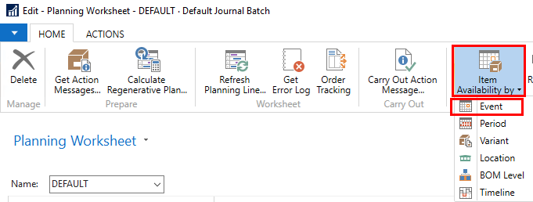
Advanced Features For The Planner
Why ? Item Availability By Event
Notes:
We help small and medium size businesses leverage technology to become more productive and profitable. (Give examples of what we do for some of these companies.)

Slide 25
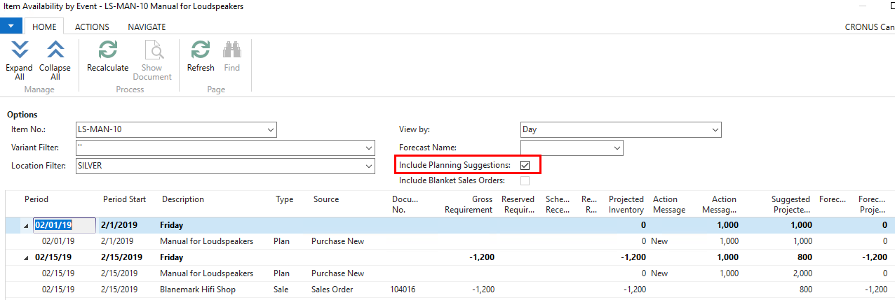
Advanced Features For The Planner
Why ? Item Availability By Event
Notes:
We help small and medium size businesses leverage technology to become more productive and profitable. (Give examples of what we do for some of these companies.)

Slide 26
Advanced Features For The Planner
Why ? Report Planning Availability
Notes:
We help small and medium size businesses leverage technology to become more productive and profitable. (Give examples of what we do for some of these companies.)

Slide 27
Any Questions?

Slide 28
Thank You for Attending!

