Slide 1
Reserved for Intro Picture
NAV Real World Tips for NAV Manufacturing
Please contact Tim for Assistance
John Grant
Sr. Application Consultant
jgrant@innovia.com
Kevin Fons
Sr. Application Consultant
kfons@innovia.com
Picture
Picture

Slide 2
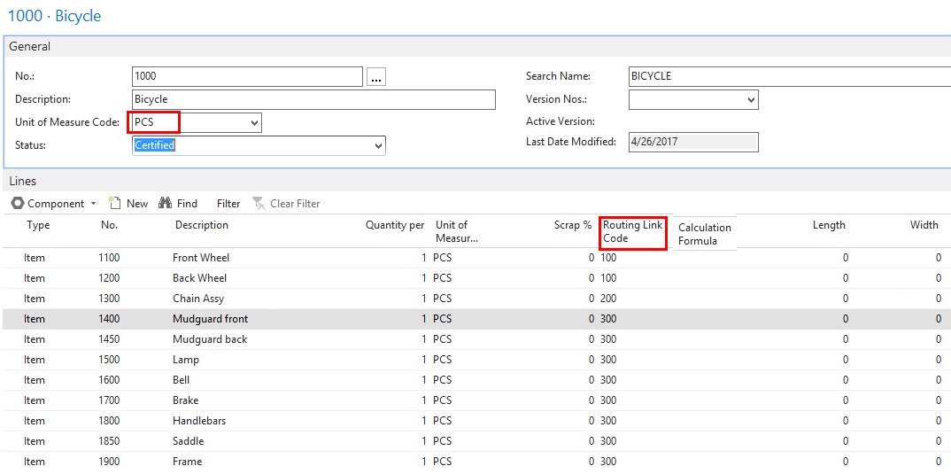
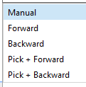
Bill of Material
Unit of Measure Code
Routing Link Code
Flushing Methods
Notes:
Kevin
Unit of measure code -100 lb. batch, lots of decimal places
Routing Link Code – link material to specific routing operation, longer run job some material later.
Flush Method – On Item Card not in the BOM, when you have a production order you can modify per order
Can impact how you setup your routings

Slide 3
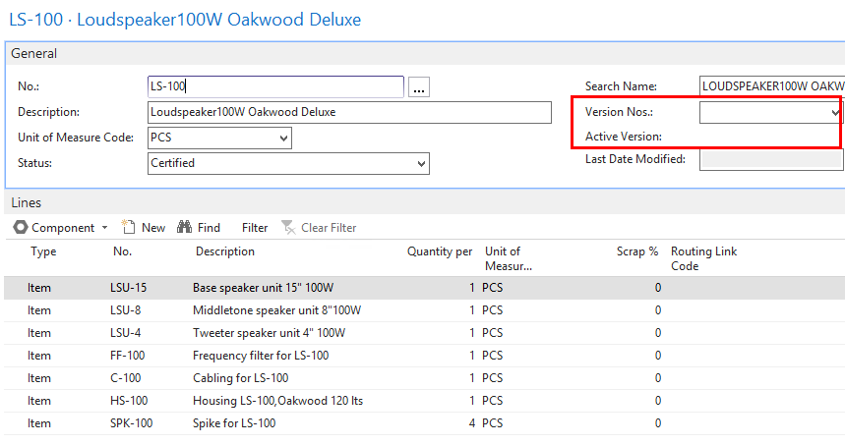
BOM versions window
Notes:
Kevin
BOM version (also on Routings) page you open is original BOM, not active version.
Need to drill down to active version.
Can update individual production orders to different version.
Alternate is to use Alternate BOM (item 123-1, item 123-2)

Slide 4
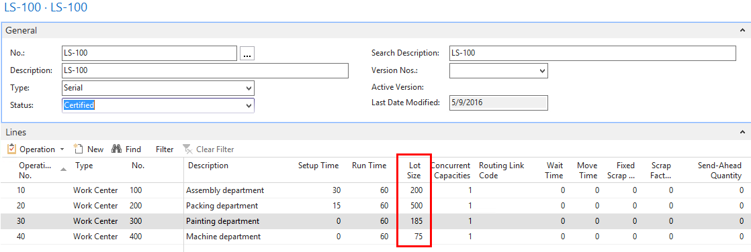
Routings
Lot Size Send Ahead
Flushing Routing Link Code
Concurrent Capacities Version
Notes:
Kevin
Lot Size – How many pieces you can make in the run time (if it’s 1 hour it’s pcs per hour)
Flushing – Set on Work Center, can change on the production order
Concurrent capacities – run on 2 machines at once, add people reduces the scheduling time (same number of hours) but will double the setup
Send ahead Quantity – after the first 10 pcs (pallet) you can start the next operation
Routing Link Code – links material to operation
Version – Same as BOM you can have versions or alternate routings

Slide 5
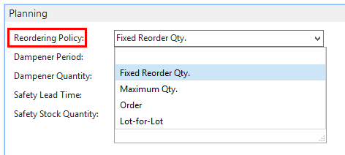
Reorder Policies
Notes:
John

Slide 6
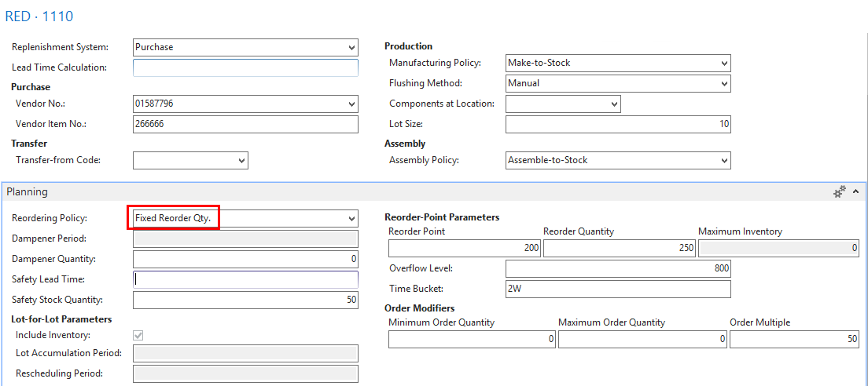
Reorder Policies – Fixed Reorder Qty.
Notes:
John

Slide 7
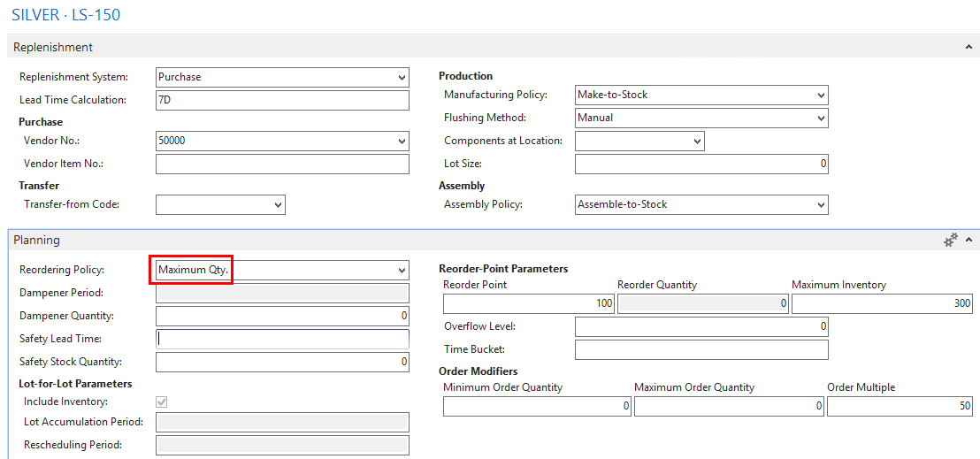
Reorder Policies – Maximum Qty.
Notes:
John

Slide 8
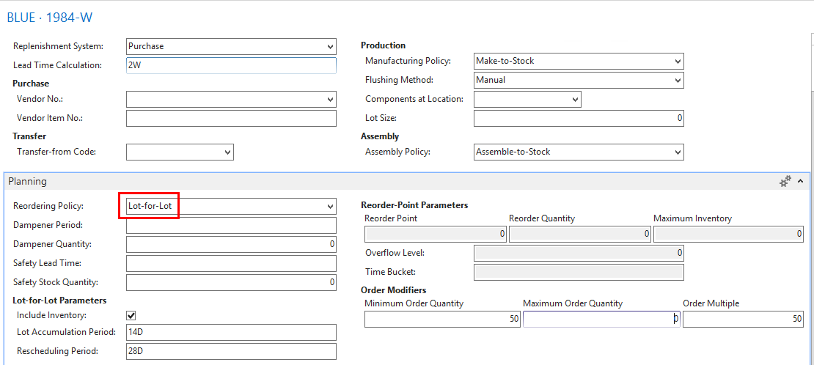
Reorder Policies – Lot-for Lot
Notes:
John

Slide 9
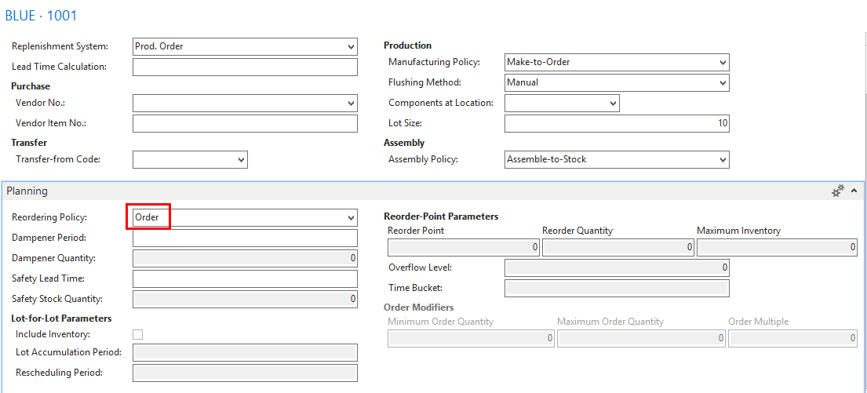
Reorder Policies - Order
Notes:
John

Slide 10
Make to Stock / Make to Order
Prod. Order Manufacturing Policy
Notes:
John

Slide 11
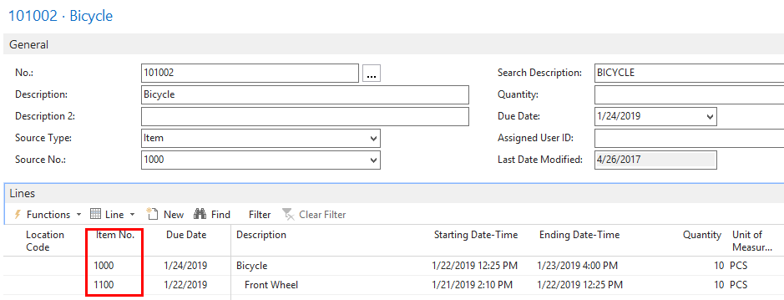
Make to Stock / Make to Order
Prod. Order Manufacturing Policy – Sub assembly MTO
Notes:
John

Slide 12
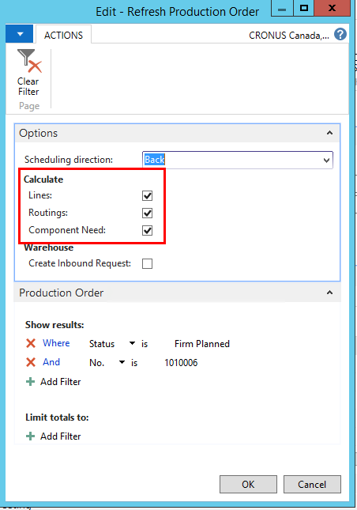
Refresh Production Orders
Notes:
Kevin
When you manually create Prod Orders, or you change the BOM you need to refresh the production order
You can refresh Line, Routing, or Bill (component need)

Slide 13
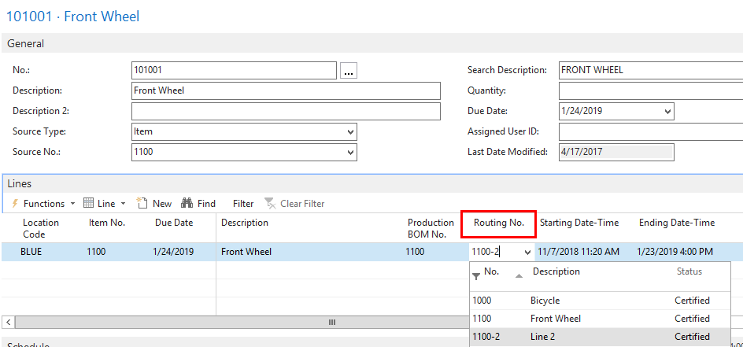
Refresh Production Orders
Notes:
Kevin
You can manually change the Routing No on the line and then refresh the Routing Only and it will replace the routing with the new one on the line (do not refresh the line)
You can do the same for the Production BOM
If you have changed a bill of Material or Routing on the production order manually you may not want to refresh any of the options.

Slide 14
Production Planner Sample Work Flow
Production Orders Created as FIRM PLANNED
Change Production Order Status Worksheet
Select Firm Planned through an End or Start date
Sort view by End Date or Start Date
Create Excel worksheet for notes
Process from earliest end date forward
Run Production Order Shortage List
Change Status to RELEASED / Print Shop Packet
Notes:
Kevin
Typical flow for a Production Floor Scheduler
Orders are in firm planned status
In the firm planned orders list view you can filter based on a start or end date
Some people will copy and paste to excel so they can add notes
Run the production order shortage list for the order
Change the order status to released, print the shop packet and send to the floor

Slide 15
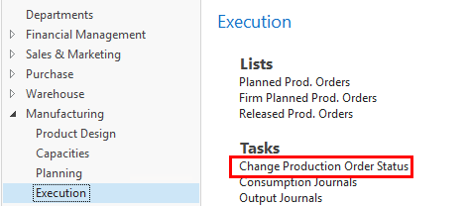
Production Planner Sample Work Flow
Notes:
Kevin
You can change multiple order status’ with the Change Production Order Status page
For example Frim Planned Orders ending before 9/24/19 – change to release
Used when you might release orders all orders due next week to the floor with or without shortages.

Slide 16
Production Planner Sample Work Flow
Notes:
Kevin
Example of the Firm planned orders (can filter the list), review shortages and Change Status (for one order at a time)
You can also run the shortage report for a range of orders (stock report will only show orders with shortages, some customer change the report so if there are no shortages it lists the order and says no shortages)
Then you can release the individual order via the Change Status in the ribbon

Slide 17
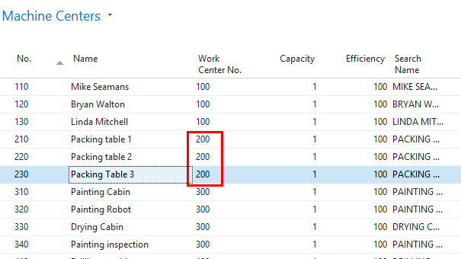
Work Centers / Machine Centers
Move work from a Work Center to a Machine Center
Notes:
John

Slide 18
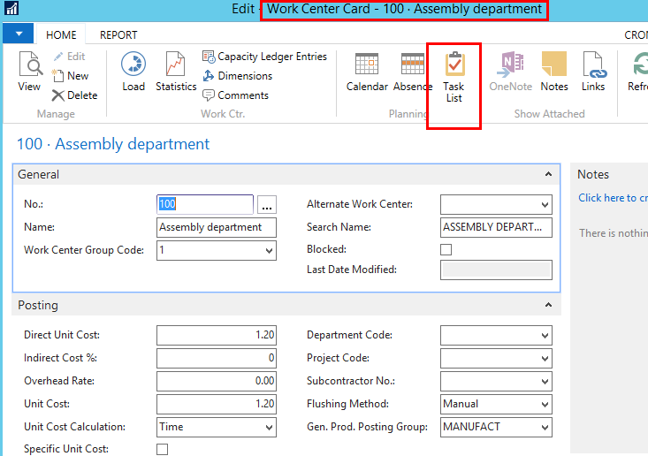
Updating Work Center to Machine Center
Notes:
John

Slide 19
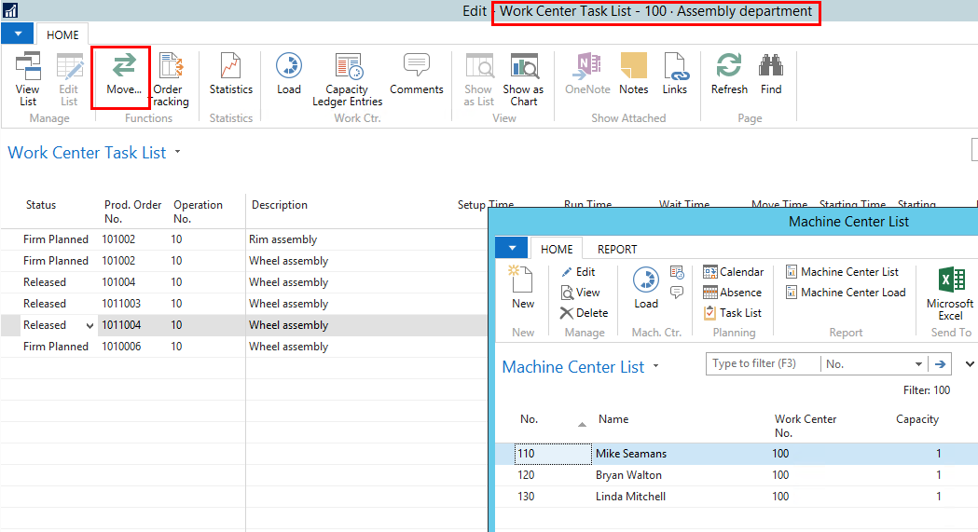
Updating Work Center to Machine Center
Notes:
John

Slide 20
Production / Assembly Due Date
Production Order
Assembly Order
Notes:
John

Slide 21
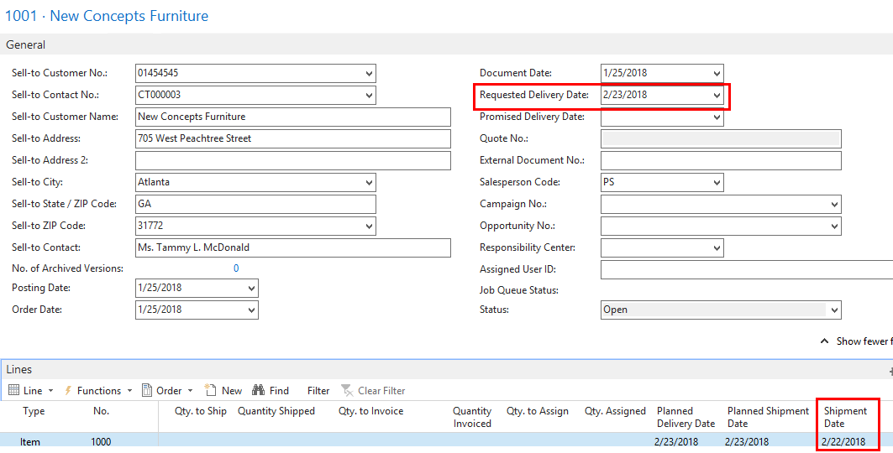
Shipment Date
Notes:
John

Slide 22
Production Ending Date / Due Date
Default Safety Lead Time
Notes:
John

Slide 23
Sales Order Planned Shipment Date
Customer Shipping Time
Customer Base Calendar
Notes:
John

Slide 24
Planning Worksheet – Ending Date
Prod. Order
Safety Lead Time 2D
Purchase Item
Lead Time
Notes:
John

Slide 25
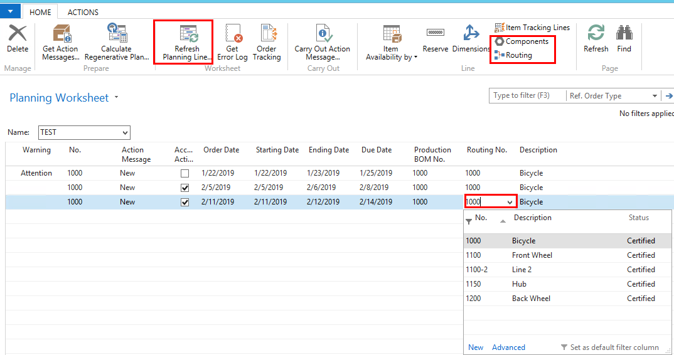
Planning Worksheet – Prod. Order
Change Routing / Bill of Materials
New Prod Order
Notes:
Kevin

Slide 26
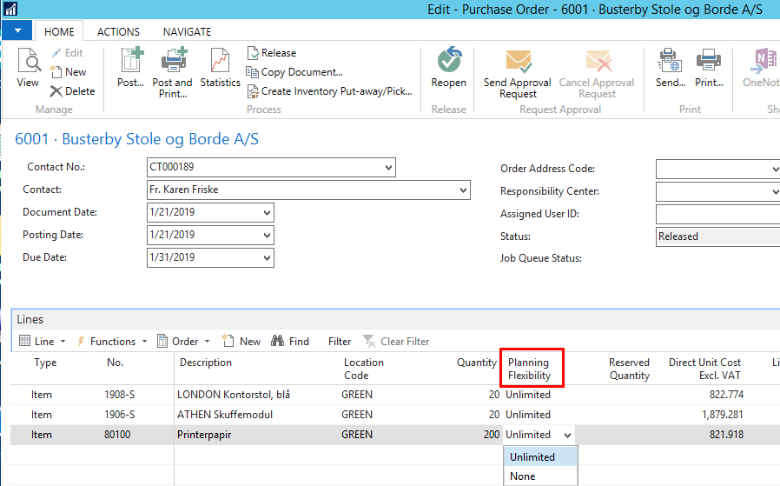
Planning Flexibility
Purchase Order Planning Flexibility
Notes:
John

Slide 27
Planning Flexibility
Production Order Planning Flexibility
Notes:
John

Slide 28
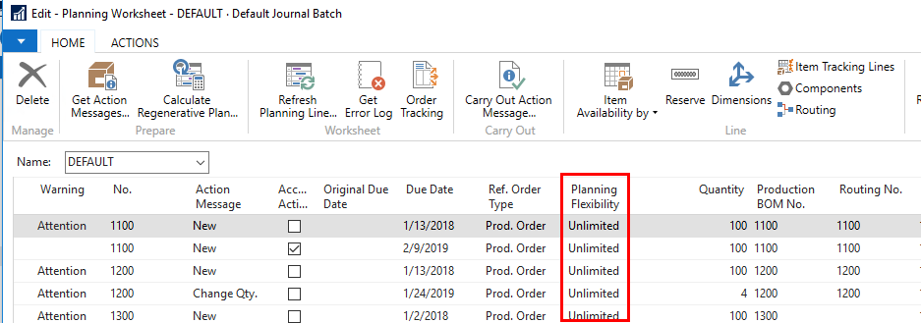
Planning Flexibility
Planning Worksheet
Notes:
John

Slide 29
Any Questions?

Slide 30
Thank You for Attending!

