Slide 1
Reserved for Intro Picture
Dimensions 101
Please contact Tim for Assistance
Mark J. Kane, CPA
Senior Application Consultant
mkane@Innovia.com

Slide 2
Introduction
Are you currently using Dimensions? Did you know they are not just for Financial Reporting?
Even though Dimensions are primarily used in reporting financial information, did you know that they can be used to report on critical data for Customers, Vendors, Items, Resources and Jobs? Dimensions in Dynamics NAV can be attached with master records to report such information as Customer or Vendor type, sales region, commodity code, Item type or category, resource groups and Job type categorization…. All this requires is some simple analysis on where to apply Dimension controls; Dimensions can also be reported on an individual or rolled up basis, and best part is that reporting on Dimensions can be created with Standard NAV Reporting Tools.

Slide 3
What are Dimensions?
Dimensions in NAV are simply Reporting Segments, they are used primarily for Financial Reporting, yet can be used to report on Operational results based on requirements needed by individual Departments

Slide 4
Dimensions and Dimension Values
Relationship between Dimensions and Dimension values are that of:
Dimensions- Parent or Family
Dimension Values- Children or Segments

Slide 5
Examples of Dimensions and Dimension Values
Dimensions
Dimension Values
Departments
Admin
Finance
MFG
Sales
Marketing
IT

Slide 6
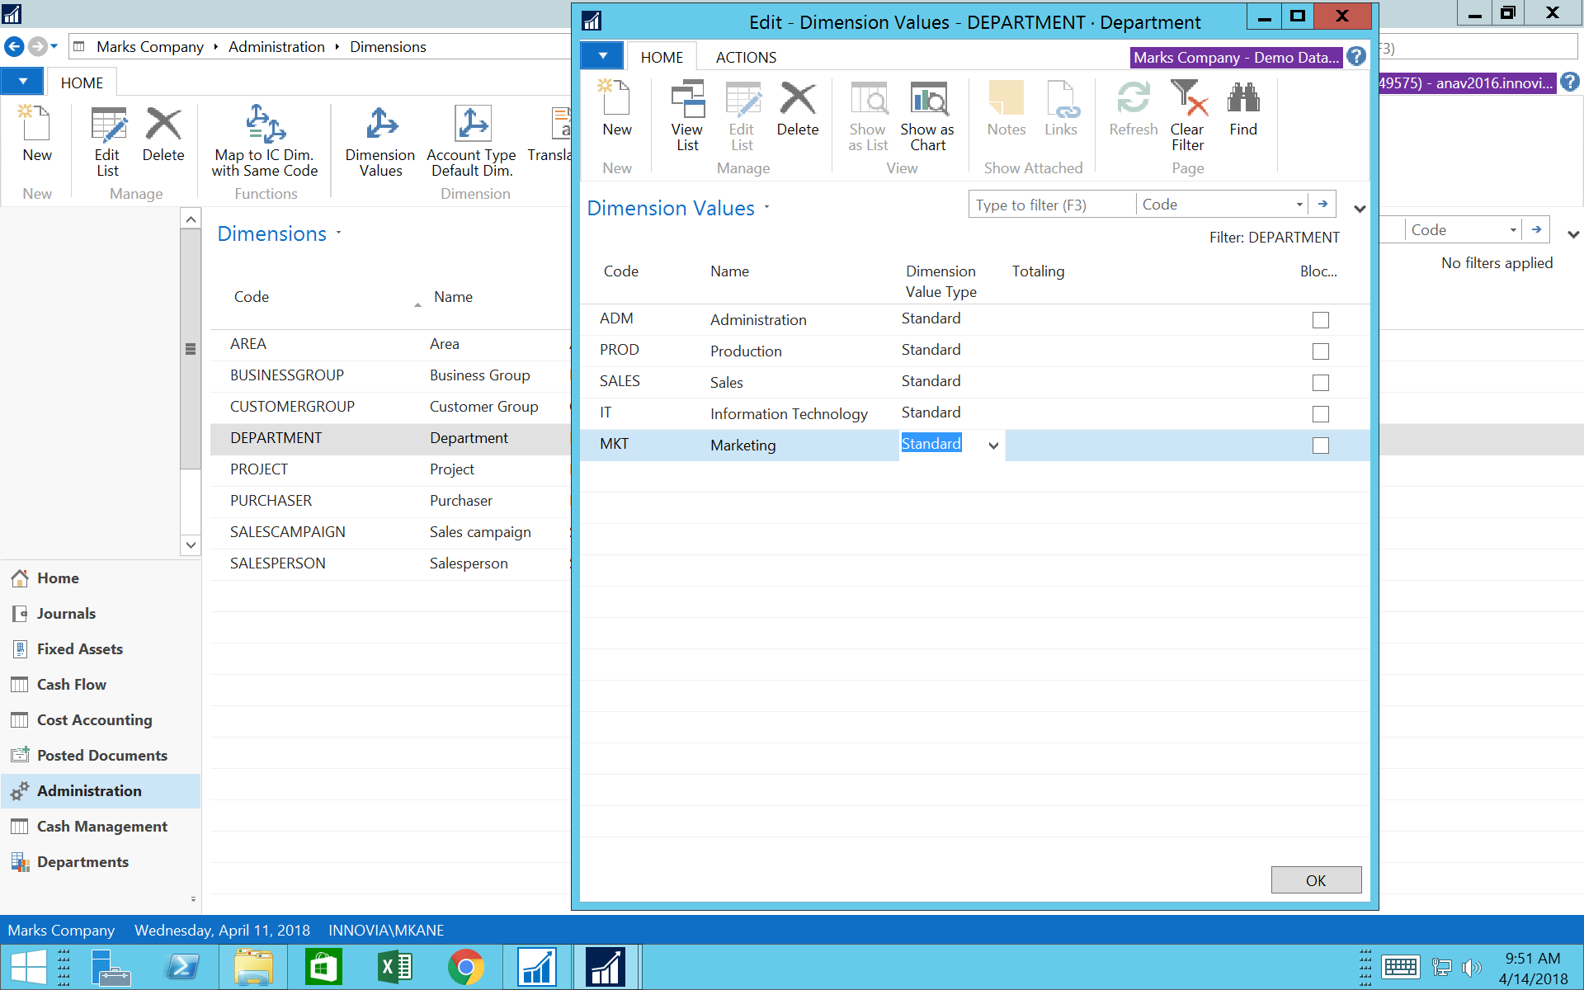

Slide 7
Categorization of Dimensions
Fixed vs. Variable
Fixed dimension- When a dimension value can be attached to a master file (Item, vendor, customer) which results in that exact same value being passed everytime this master file is used (one to one)
Variable dimension- When a dimension value is required, but the exact value would not be selected until time of transaction (one to many)

Slide 8
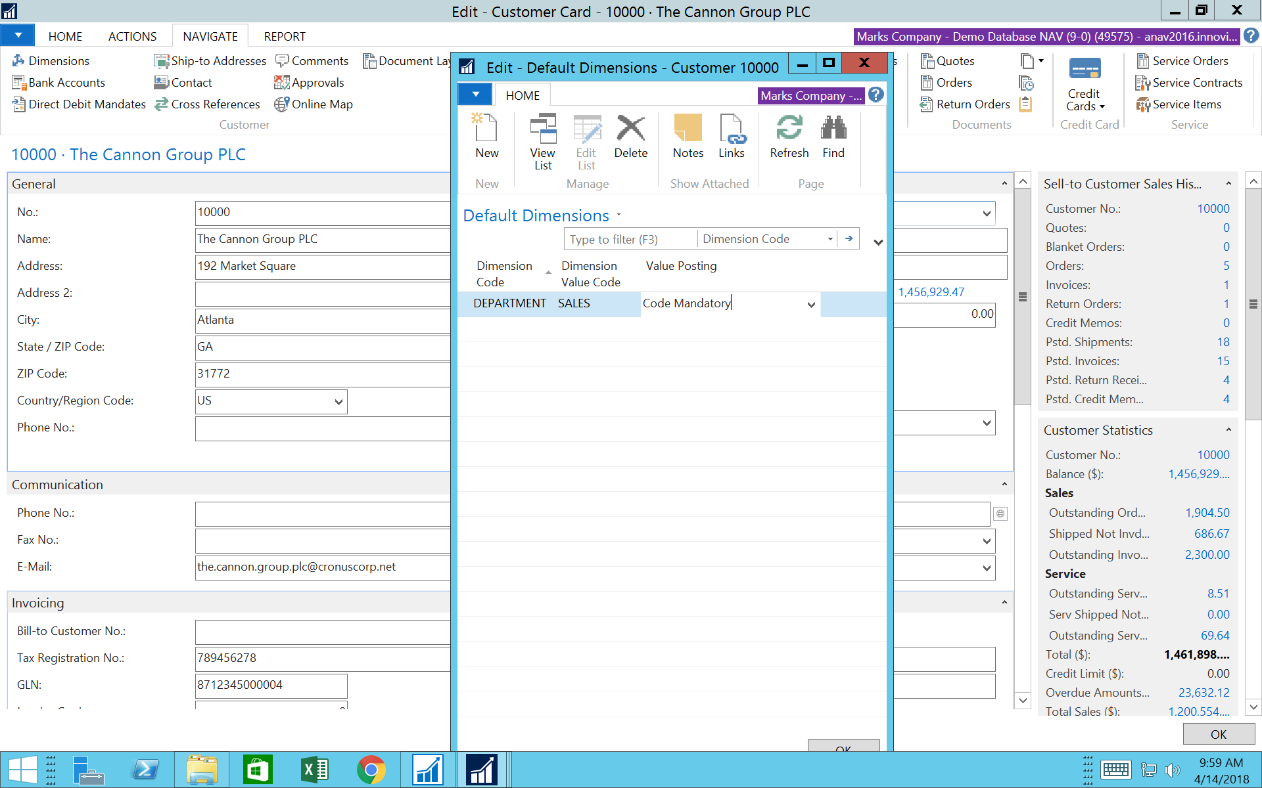
Fixed

Slide 9
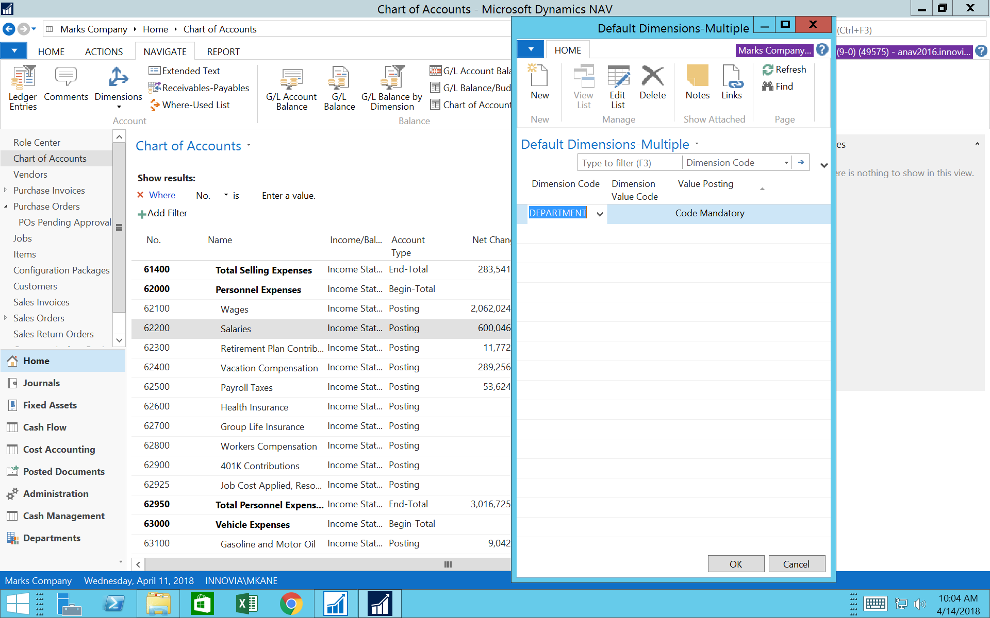
Variable

Slide 10
Attaching and Assigning Dimension Controls
General Ledger Level-setting GL account level controls will prevent missing Dimension Values at the time of data entry
Master Files-setting recurring dimension at the master file level will eliminate data entry of recurring values when same data is always us

Slide 11
Dimension Value Roll Up
Dimension Values can be rolled up and summarized in the same manner as the General Ledger Chart of Accounts
By using Beginning Total and Ending Total Dimension values, all Dimension Values between this range can be summarized for reporting purposes

Slide 12
Dimension Value Roll Up

Slide 13
Transactional example- Posted Sales Invoice
In the following example, a Sales Order was created, shipped and invoiced; by selecting only the Customer and Item to be shipped, you will see the Dimension Values that were passed from these Master Files

Slide 14
Posted Sales Invoice

Slide 15
Reporting Options
Utilizing Dimensions and Dimension Values enables the user to perform Financial and Operation reporting utilizing standard NAV reporting tools
Analysis by Dimension
Preview multiple displays utilizing Dimension filters
Complete drill down to source documents
Ability to create Pivot Tables from Analysis View
Jet Express- free version of Jet can be used as dimension values are accessible in GL Tables

Slide 16
Analysis by Dimensions

Slide 17
Analysis by Dimensions

Slide 18
Analysis by Dimensions

Slide 19
Analysis by Dimensions

Slide 20
Analysis by Dimensions

Slide 21
Analysis by Dimensions

Slide 22
Benefits of using Dimensions
Ability to report on both Financial and Operational data through NAV GL
Easy to set up at any point in time
Eliminates repetitive entries
Enable controls on Master File (Cards) and GL level to eliminate missing reporting data

Slide 23
Any Questions?
Mark J. Kane, CPA
mkane@Innovia.com

Slide 24
Thank You for Attending!

